Slide 1
Chapter 12. Time series models
Financial Econometrics
Department of financial engineering
Zhongnan university of economics and law
Xu Yonghao

Slide 2
oUTLINE
Introduction
AR
Basic Concepts
MA

Slide 3
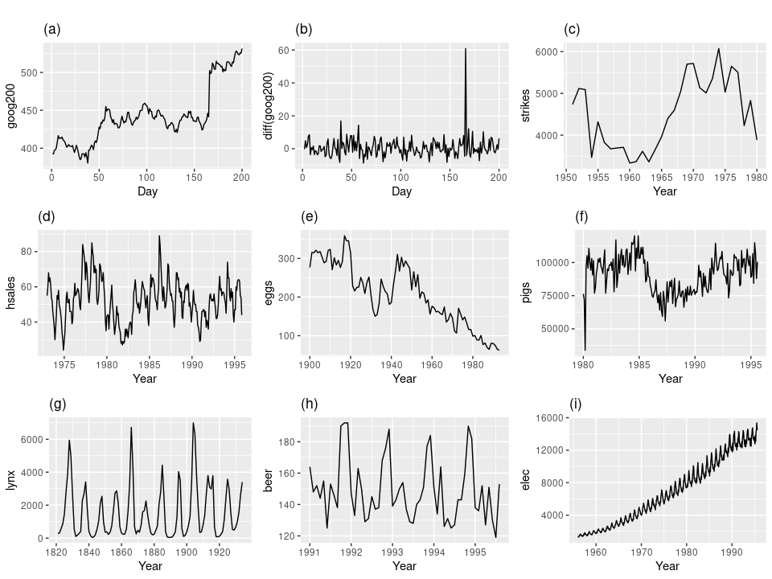
1 Introduction
Source:https://otexts.com/fpp2/stationarity.html

Slide 4
1 Introduction
What is Time Series Analysis?
The analysis of data organized across units of time.
Time series is a basic research design
Data for one or more variables is collected for many observations at different time periods
Usually regularly spaced
May be either
univariate - one variable description
multivariate - causal explanation

Slide 5
1 Introduction - Time Series vs. Cross Sectional Designs
It is usually contrasted to cross-sectional designs where the data is organized across a number of similar units
The data is collected at the same time for every observation
Thus:
A data set consisting of 50 states for the year 1998 is a cross-sectional design.
A data set consisting of data for Alabama for 1948 – 1998 is a time series design.

Slide 6
1 Introduction - Time Series vs. Cross Sectional Designs
Depends on your question
If you wish to explain why one state is different from another, use a cross-sectional design
If you wish to explain why a particular state has changed over time, use a time series design

Slide 7
1 Introduction – using OLS? No
问题1：单个股票的系统风险beta如何估计？
用时间系列数据有什么问题吗？
我们知道OLS的无偏性的前提是
假设1：线性模型
假设2：随机抽样
假设3：非完全共线性
假设4：外生性：
时间系列数据显然不满足假设2。

Slide 8
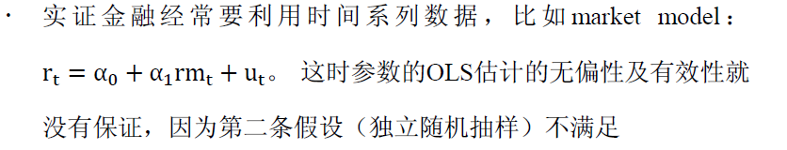
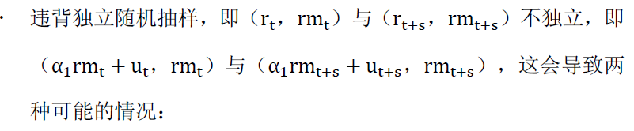

1 Introduction

Slide 9
1 Introduction
Unbiasedness and Consistency
we can prove unbiasedness (and/or consistency) of the OLS estimator under the first four assumptions
Identical as for heteroscedasticity
Inference
The direct t-test (F test) is not valid since we don’t have the variance estimator
In the proof, we need the no series correlation assumption.
For example, consider AR(1) error and simple OLS estimator

Slide 10
1 Introduction
Efficiency
not BLUE
Detection of autocorrelation : Statistical test
We need to know the pattern of series correlation
While there are numerous ways in which the error terms in a multiple regression model can be serially correlated, the most popular model—and the simplest to work with—is the AR(1) model
Testing procedure is similar to that for heteroscadesticity

Slide 11
2 Basic Concepts
Period
Cycle
Season
Stationarity
Trend
Drift

Slide 12
2.1 Periodicity – 时间区间
The Period
A Time Series design is simple to distinguish because of its period. The data set is comprised of measures taken at differing points in time. The unit of the analysis is the period. (i.e. daily, weekly, monthly, quarterly, annual, etc.)
Note that the period defines the discrete time interval over which the data measurement are taken.
Source in this section: Asst. Prof. Dr. Mete Feridun Department of Banking and Finance Faculty of Business and Economics Eastern Mediterranean University

Slide 13
2.2 Cycle – 周期
Uses classic trigonometric functions such as the sine and cosine functions to examine periodicity in the data.
This is the basis for Fourier Series and Spectral Analysis.
Used primarily in economics where they have data series measured over a long period of time with multiple regularly occurring and overlapping cycles. (Rarely used in Political Science, but try the commodity markets, with hog/beef/chicken cycles)

Slide 14
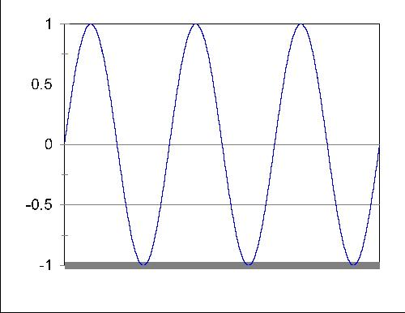
2.2 Cycles
A simple cyclic or trigonometric function might look like this:

Slide 15
2.2 Cycles
You could estimate a model like
But why would you?
What theory do you have that suggests that political data follow such trigonometric periodicity?
Are wars cyclic? Sunspots?
Would elections be cyclic?

Slide 16
2.3 Seasonality
Season
Sometimes, when a relationship or a data series has variation related to the unit of time, we often refer to this as seasonality.
(e.g. Christmas sales, January tax revenues.)
This most often occurs when we have discrete data.
Seasonality is thus the discrete data equivalent of the continuous data assumed by spectral analysis

Slide 17
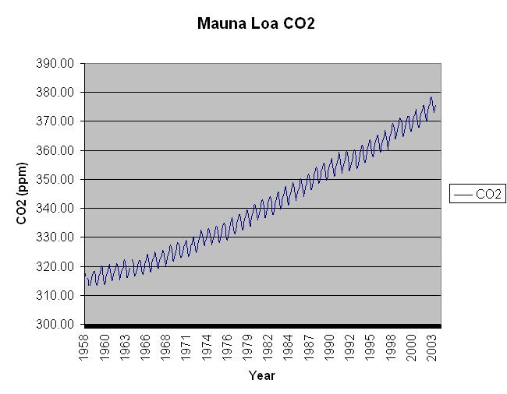
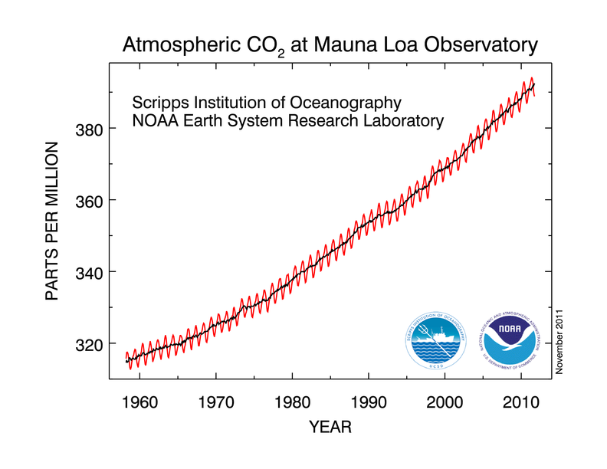
2.3 Seasonality
莫纳罗亚火山

Slide 18
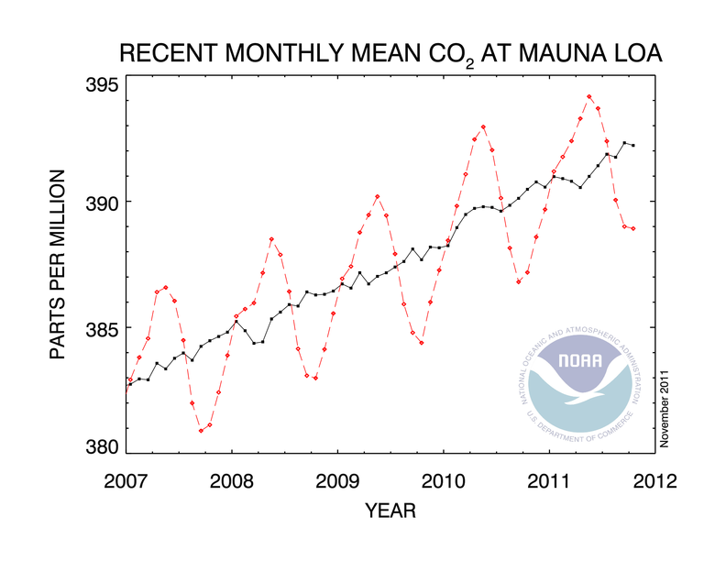
A closer look

Slide 19
2.3 Regression with Seasonal Effects
Estimating a regression model with seasonal behavior in the dependent variable is relatively easy:
Where S₁ is a seasonal dummy.
S₁ is coded 1 when the observation occurs during that season, and 0 otherwise.)

Slide 20
2.3 Estimating Seasonality
Like all dummy variable models, at least one Season (Category) must be excluded from the estimation
The intercept represents the mean of the excluded season(s).
Failure to exclude one of the seasonal dummies will result in:
A seasonal variable being dropped, or
biased estimation at best and in all likelihood error messages about singular matrices or extreme multicolinearity.
The slope coefficients represent the change from the intercept.
t-tests are tests of whether the seasons are different from the intercept, not just different from 0.

Slide 21
2.4 Stationarity
If a time series is stationary it means that the data fluctuates about a mean or constant level.
Many time series models assume equilibrium processes.

Slide 22
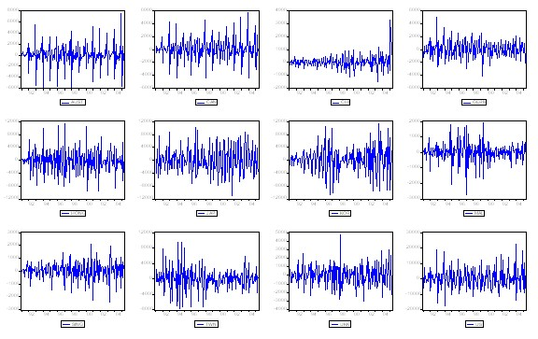
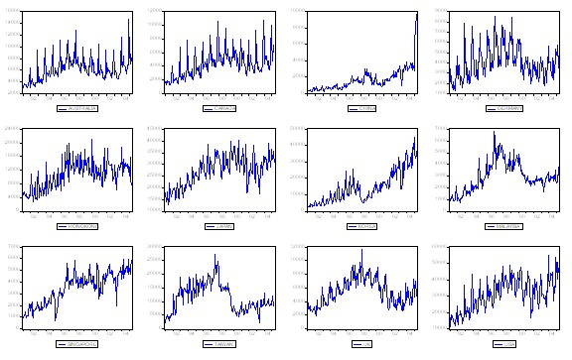
2.4 Stationarity

Slide 23
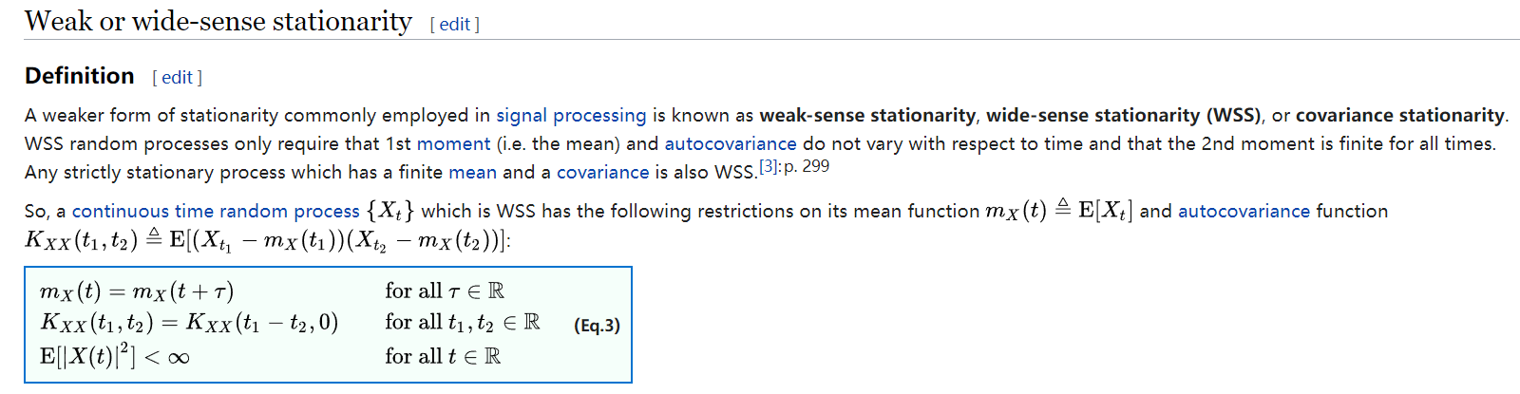
2.4 Stationarity - DeF
What does weak stationarity mean in practice?
Past: time plot of {Xt} varies around a fixed level within a finite range!
Future: the first 2 moments of future {Xt} are the same as those of the data so that meaningful inferences can be made.
Sample moment can be used as the estimates of the unconditional moments

Slide 24
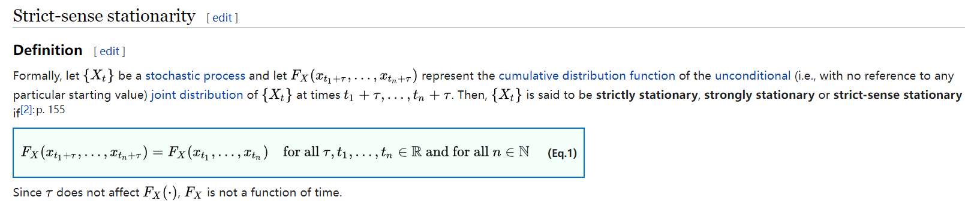
2.4 Stationarity - DeF
It is obviously that strong (strictly) stationary series is also weakly stationary if it has finite second moment
For normally distributed random variables, weakly stationary is also strictly stationary
In finance, weak rather than strong stationarity is often discussed
How to test stationarity?
Statistically, we can do it and will discuss it later.
Sometimes we rely on economic intuition
Interest rate process

Slide 25
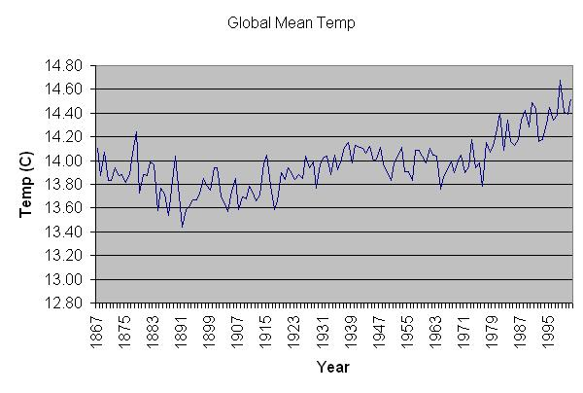
2.4 Example of Non-Stationarity

Slide 26
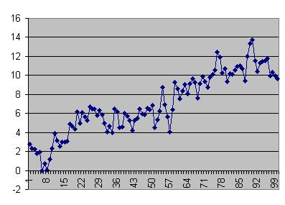
2.5 tREND
Trend indicates that the data increases or decreases regularly.

Slide 27
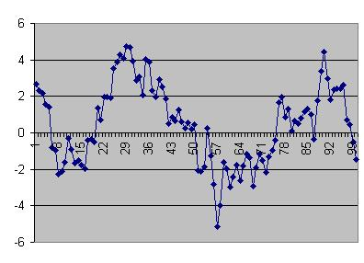
2.6 Drift
Drift means that the series ‘drifts’ away from its mean, but then drifts back at some later point.

Slide 28
2.7 Random Walk
If the data is generated by
We call it a random-walk.
If B is equal to 0.0, the data is a pure random walk.
If B is non-zero, then the series drifts away from the mean for periods of time, but may return (hence often called drift, or drift non-stationarity).

Slide 29
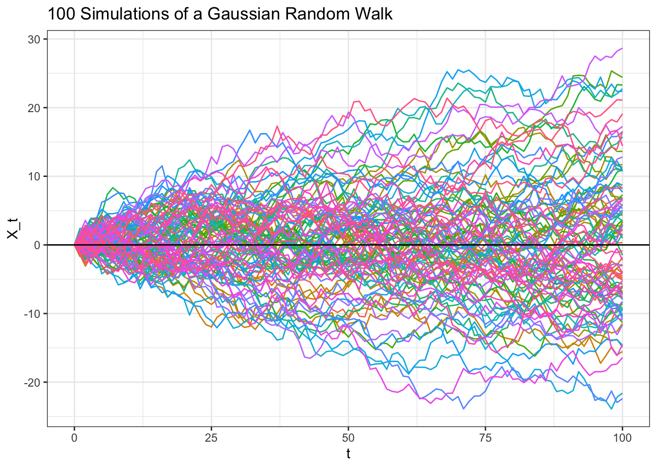
2.7 Random Walk

Slide 30
3 AR - Autoregressive Model
ARMA 模型，一元线性时间系列模型的标准形式，构成了时间系列计量经济学的基础。其一般形式为
我们讨论这个模型有以下几个理由：
它本身是一个预测模型，特别是用于季节性问题时
帮助我们了解时间系列模型及数据的平稳性问题
帮助我们了解时间系列模型的参数估计，模型选择及预测
是随机波动率模型（GARCH）的基础
是多元线性时间系列模型（VAR）的基础
它由两部分组成：AR（自回归）和MA（移动平均）。我们先分别讨论这两部分。

Slide 31

3.1 Autoregressive Model
AR模型是最简单的预测模型。什么是预测？让历史告诉未来，最简单的是本身的历史，即AR模型。比如今年的GDP增长如何依赖去年的GDP的增长。
为了更好地理解AR模型，我们先看看它的确定性部分
这是一个差分方程
因为AR（p）的许多性质与差分方程类似，而差分方程容易分析得多，我们先看差分方程的性质

Slide 32

3.1 Autoregressive Model - Theory

Slide 33

3.1 Autoregressive Model

Slide 34







Slide 35


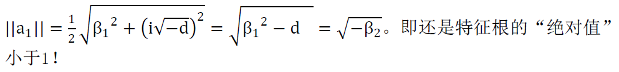

Slide 36

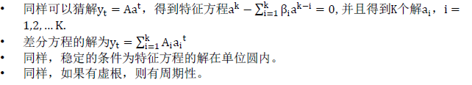
3.1 Autoregressive Model

Slide 37



Properties of AR process
把扰动项加到差分方程，就是我们的AR模型。
平均来看，扰动为零。差分方程的性质就是AR模型的性质
稳定的条件？
均值和方差？
自回归系数方程：
快速下降到0
后面要讨论的单位根过程是一个特殊的AR（1）过程

Slide 38


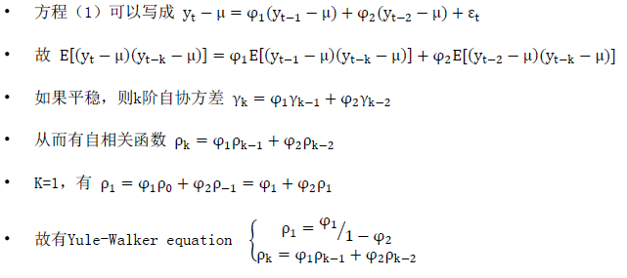
0> ϕ1 >-1 也是mean-reverting，但是正负跳跃地回归。不如前面的有persistence

Slide 39
3.1 Autoregressive Model
自相关系数可以有跳跃（正负间）
平稳条件、均值、方差、协方差等的推导过程如AR(2)
AR(k) , k>1 可能有周期性

Slide 40
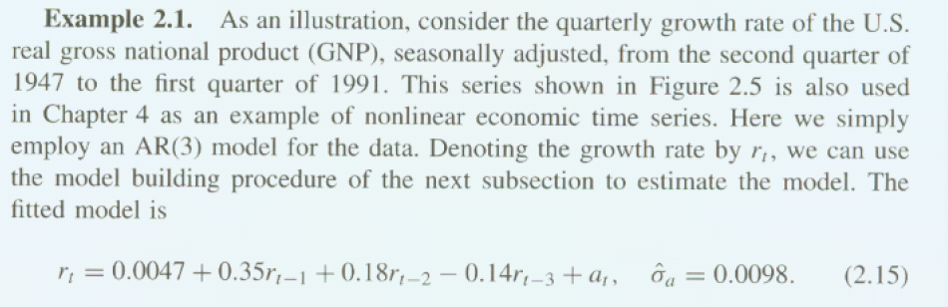
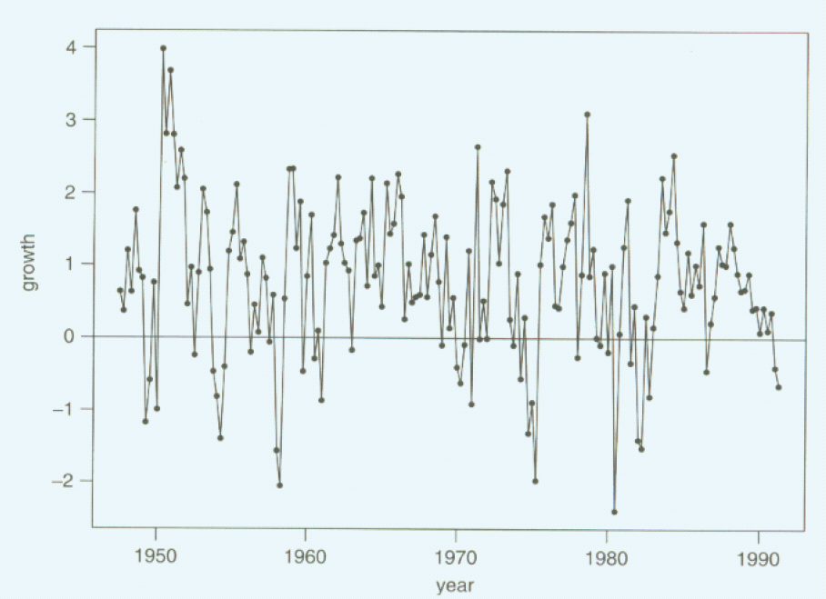
3.2 AR - EXAMPLE

Slide 41


3.2 AR - EXAMPLE
特征方程为
有一个收敛实根-0.52，两个收敛虚根d=-0.323 < 0，
由于虚根，所以有周期性，周期为10.83,计算过程为

Slide 42
3.2 AR - EXAMPLE
因此，美国GNP表现为一个均值回归与一个以10.83个季度为周期的两个过程的合成。
那上面的模型哪来的？需要模型的设定和估计。我们先讨论估计问题
设定，AR(K)，k如何取的问题

Slide 43
3.3 ar - estimation
Identifying AR model
包括两部分：Order （model）selection， Parameter estimation
我们先讨论parameter estimation
在模型给定（AR(k)) 的情况下，我们可以用OLS来估计模型参数？
由于AR模型不可能满足严格外生的条件，因此只有在满足当期外生及弱相关的条件时，可以用OLS。
而平稳的AR过程肯定是弱相关
我们前面讨论了什么样的AR过程是平稳的，但那是在AR模型的参数已知的情况下。如何事前判断？
后面讨论
事实上，在误差为正态分布时，AR模型的OLS估计等同于MLE估计
为了模型选择的原因，我们将介绍MLE估计

Slide 44
3.3 ar - estimation
假定我们有某时间序列的T个样本观测值
和 AR（1）的未知参数
联合分布密度函数（似然函数）为
where

Slide 45
3.3 ar - estimation
Stationarity Test
AR k?
Forecast

Slide 46
3.3.1 Stationarity Test
Augmented Dickey-Fuller test
The Augmented Dickey-Fuller test is a type of statistical test called a unit root test.
The intuition behind a unit root test is that it determines how strongly a time series is defined by a trend.
The null hypothesis of the test is that the time series can be represented by a unit root, that it is not stationary (has some time-dependent structure). The alternate hypothesis (rejecting the null hypothesis) is that the time series is stationary.

Slide 47
3.3.1 Stationarity Test
Null Hypothesis (H0): If failed to be rejected, it suggests the time series has a unit root, meaning it is non-stationary. It has some time dependent structure.
Alternate Hypothesis (H1): The null hypothesis is rejected; it suggests the time series does not have a unit root, meaning it is stationary. It does not have time-dependent structure.
We interpret this result using the p-value from the test. A p-value below a threshold (such as 5% or 1%) suggests we reject the null hypothesis (stationary), otherwise a p-value above the threshold suggests we fail to reject the null hypothesis (non-stationary).
p-value > 0.05: Fail to reject the null hypothesis (H0), the data has a unit root and is non-stationary.
p-value <= 0.05: Reject the null hypothesis (H0), the data does not have a unit root and is stationary.

Slide 48
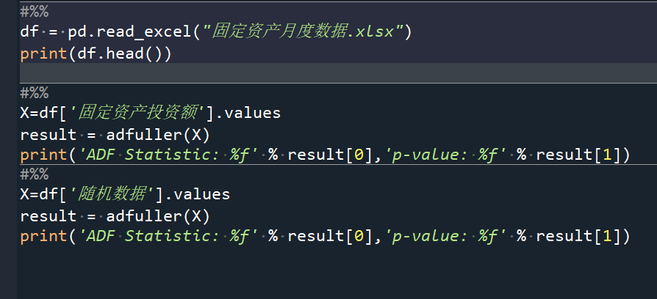
3.3.1 Stationarity Test

Slide 49
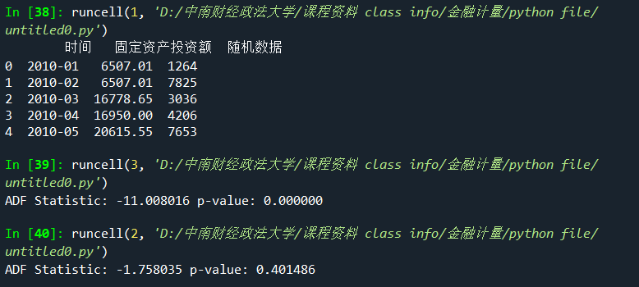
3.3.1 Stationarity Test

Slide 50
3.2 AR k?
很显然，当时间序列模型的阶数越高，其描述对象样本的能力就越强。但是阶数越高，参数也就越多，容易造成过拟合的现象。
因此我们需要找一个度量工具，来确定最佳的阶数。用的较为广泛的工具为赤池信息量准则（Akaike information criterion，简称AIC）以及贝叶斯信息量准则（Bayesian information criterion，简称BIC）。

Slide 51

3.2 AR k? – AIC & BIC
令L是模型参数的似然函数，它是一个概率函数。即MLE的最大似然估计

Slide 52


3.2 AR k? – AIC & BIC

Slide 53

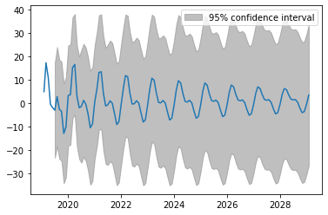
3.3 Forecast

Slide 54

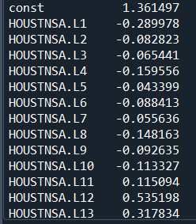
3.3 Forecast

Slide 55
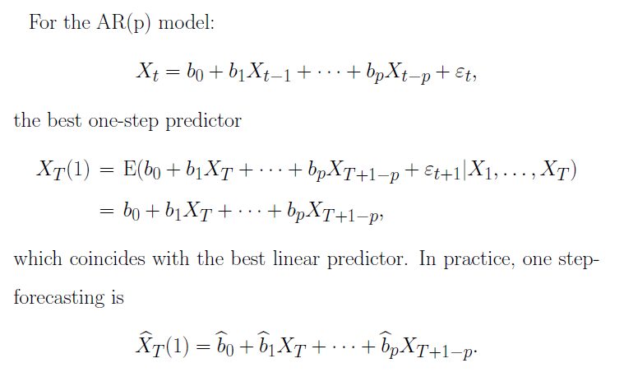
3.3 Forecast

Slide 56
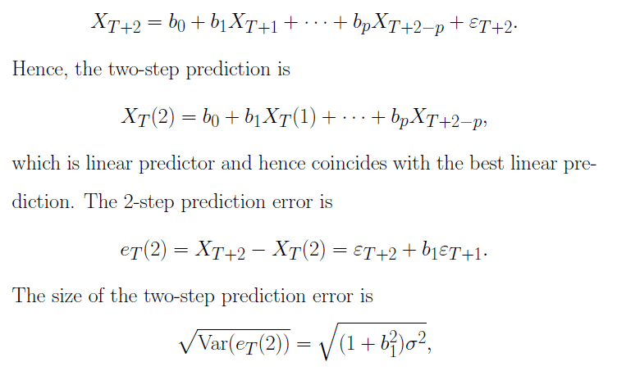
3.3 Forecast
Two-step ahead forecasting:
which is larger than one-step error, implies that uncertainty in forecasts increases as the number of steps increases.
The forecasting error variance can be used to construct confidence interval if we further assume normality

Slide 57

4.1 MA - Moving average model
MA(1) model
Stationarity: always stationary
Mean: mu
Finite memory! Finite memory, Short memory, long memory
MA(1) models do not remember what happen two time periods ago.
MA(1)显然比AR（1）简单多了
MA(k) model
性质类似于MA(1)

Slide 58


4.1 MA - Moving average model
MA model parameter estimation
OLS?
MLE
MA（1）的MLE
如果前一时期的扰动项已知，当前时期样本观测值的条件分布
而除第一个外，其它的扰动项可以用观察值迭代得出
因此，如果知道第一个扰动项，就可以写出似然函数
方法1：假设它为0（绝对均值为0）
方法2：把它当做参数估计

Slide 59
4.1 MA - Moving average model
Order selection？
Same as AR (k) model
Forecasting?
需要迭代求出扰动项。

Slide 60

Cross representation between MA and AR
这里Taylor级数收敛的条件是phi_1的绝对值小于1
正好是AR（1）的平稳条件

Slide 61
满足这个条件的MA过程称作“可反转性（Invertibility）”
Invertibility of MA models is the dual property of stationarity for AR models.
Provide a model simplifying method: represent MA(q) as AR(1) for large q, or represent AR(p) as MA(1) for large p
This method is used in GARCH model

Slide 62
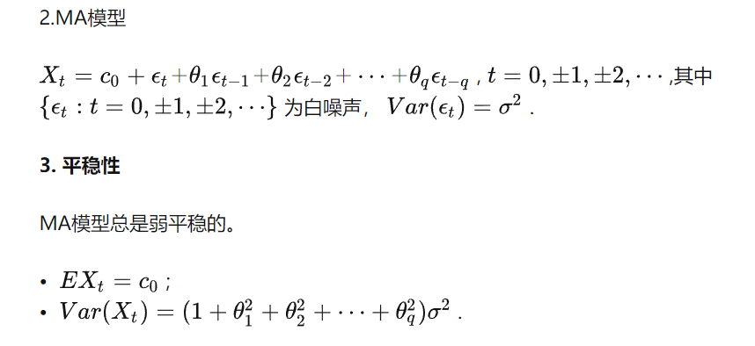
4.2 MA - property

